Slide 1
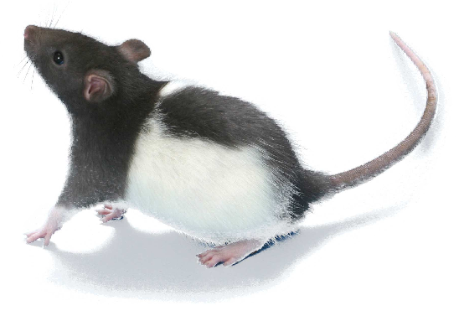
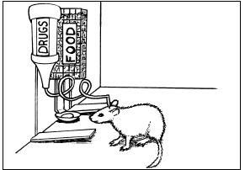
Neurological Disorders Lesson 5.3
Should animals be used in scientific research?

Slide 2
Do Now:
Divide into groups based on the “perspective” for animal research you read about last night.
Perspective 1: National Institutes of Health
Perspective 2: People for the Ethical Treatment of Animals (PETA)
Perspective 3: Americans for Medical Progress
Perspective 4: Understanding Animal Research
Perspective 5: Humane Society of United States
Review the homework questions and summarize your perspective’s view on animal research.

Slide 3
Council Meeting on Animal Use in Research
National Institutes of Health
Understanding Animal Research
People for the Ethical Treatment of Animals (PETA)
Humane Society of United States
Americans for Medical Progress

Slide 4
Council Meeting on Animal Use in Research
What historical precedents justify contemporary use or non-use of animals in scientific research?
What benefits and problems have developed because of the use or non-use of animals in scientific research?
Should animals be used in scientific research? If so, what considerations should be given to their care and well-being? If not, why not?
What kind of relationships should exist between humans and animals?

Slide 5
Reflection on Animal Use in Research
Do you think animals should be used in scientific research? If so, what considerations should be given to their care and well-being? If not, why not?
Do humans have moral responsibilities for animals or are animals destined to serve humanity?

Slide 6
Studying Addiction

Slide 7
The Brain’s Reward Circuit
Sensing Electrode
PFC
NAc
VTA

Slide 8
Studying Addiction
We know that dopamine levels rise after taking a drug.
But, does dopamine have anything to do with wanting a drug???
And, how would you test if dopamine was involved???

